Slide 1




Dhruv Sakalley https://www.linkedin.com/in/dhruv-sakalley-5146a921/
Developments in Understanding Natural Language

Slide 2
Who Am I
Data Scientist at LexisNexis, Engineer at heart.
Helping advance rule of law by with improving knowledge reach.
Applying representation learning and information extraction to Legal documents for legal research and question answering.
Fortunate to have an education in Biomedical Engineering with a focus on neuroscience, brain computer interfaces and bioinformatics.
Been a part of software product development for around 12 years.

Slide 3
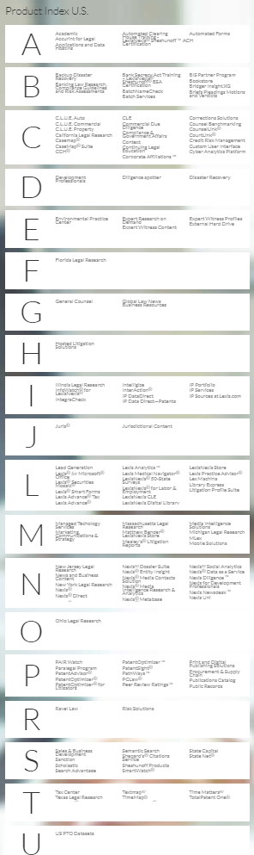



https://www.lexisnexis.com/en-us/rule-of-law/default.page
https://relx.wd3.myworkdayjobs.com/LexisNexisLegal

Slide 4
Let’s play a game

Slide 5
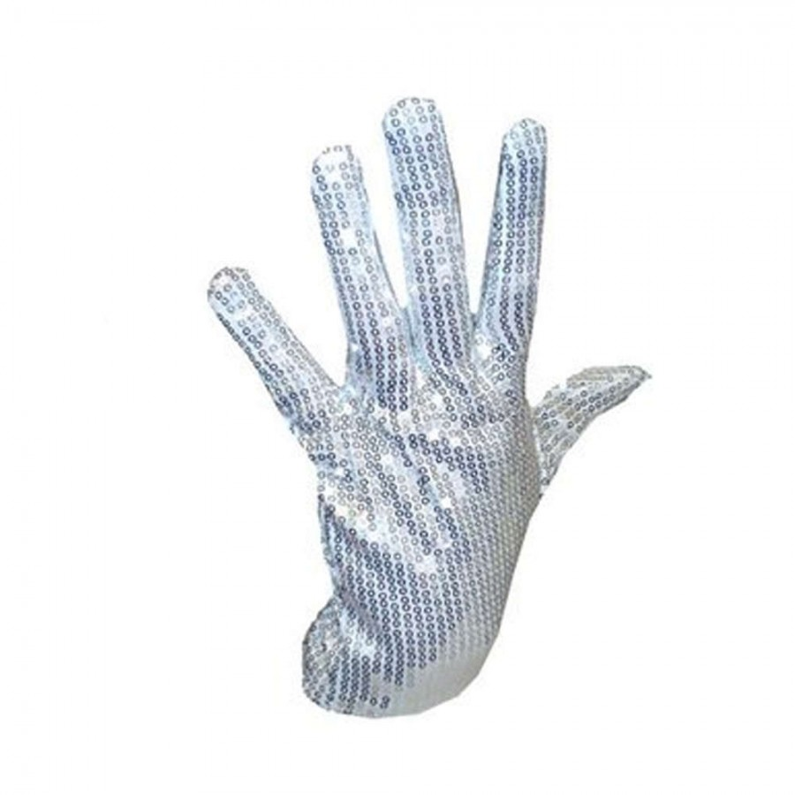

Slide 6


Slide 7


Slide 8


Slide 9
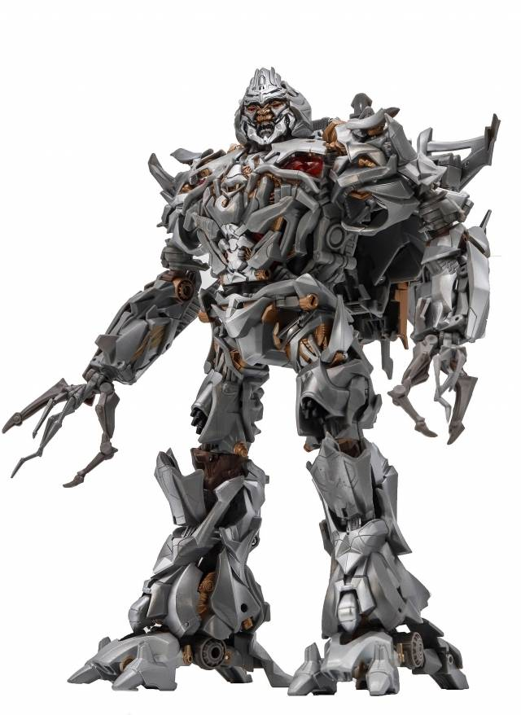

Slide 10
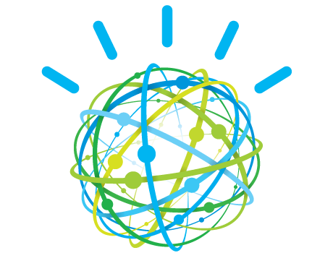

Slide 11
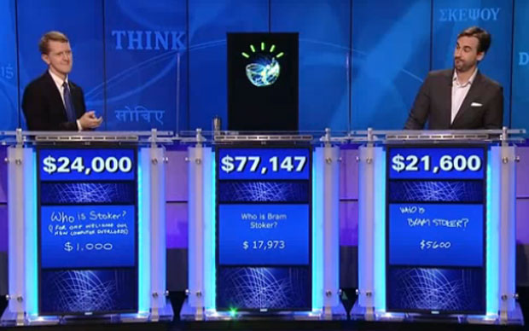

Slide 12
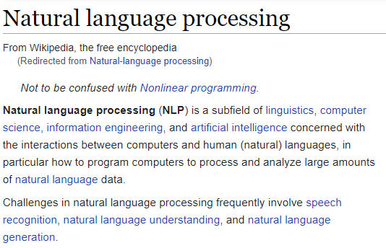
Language is the scaffold of our minds.
“We build our thoughts through language and it conditions how we experience and interact with the world." – Yueng
Natural Language Processing, Understanding or Inference provide tools for mathematically representing information in high dimensional spaces making it actionable.

Slide 13
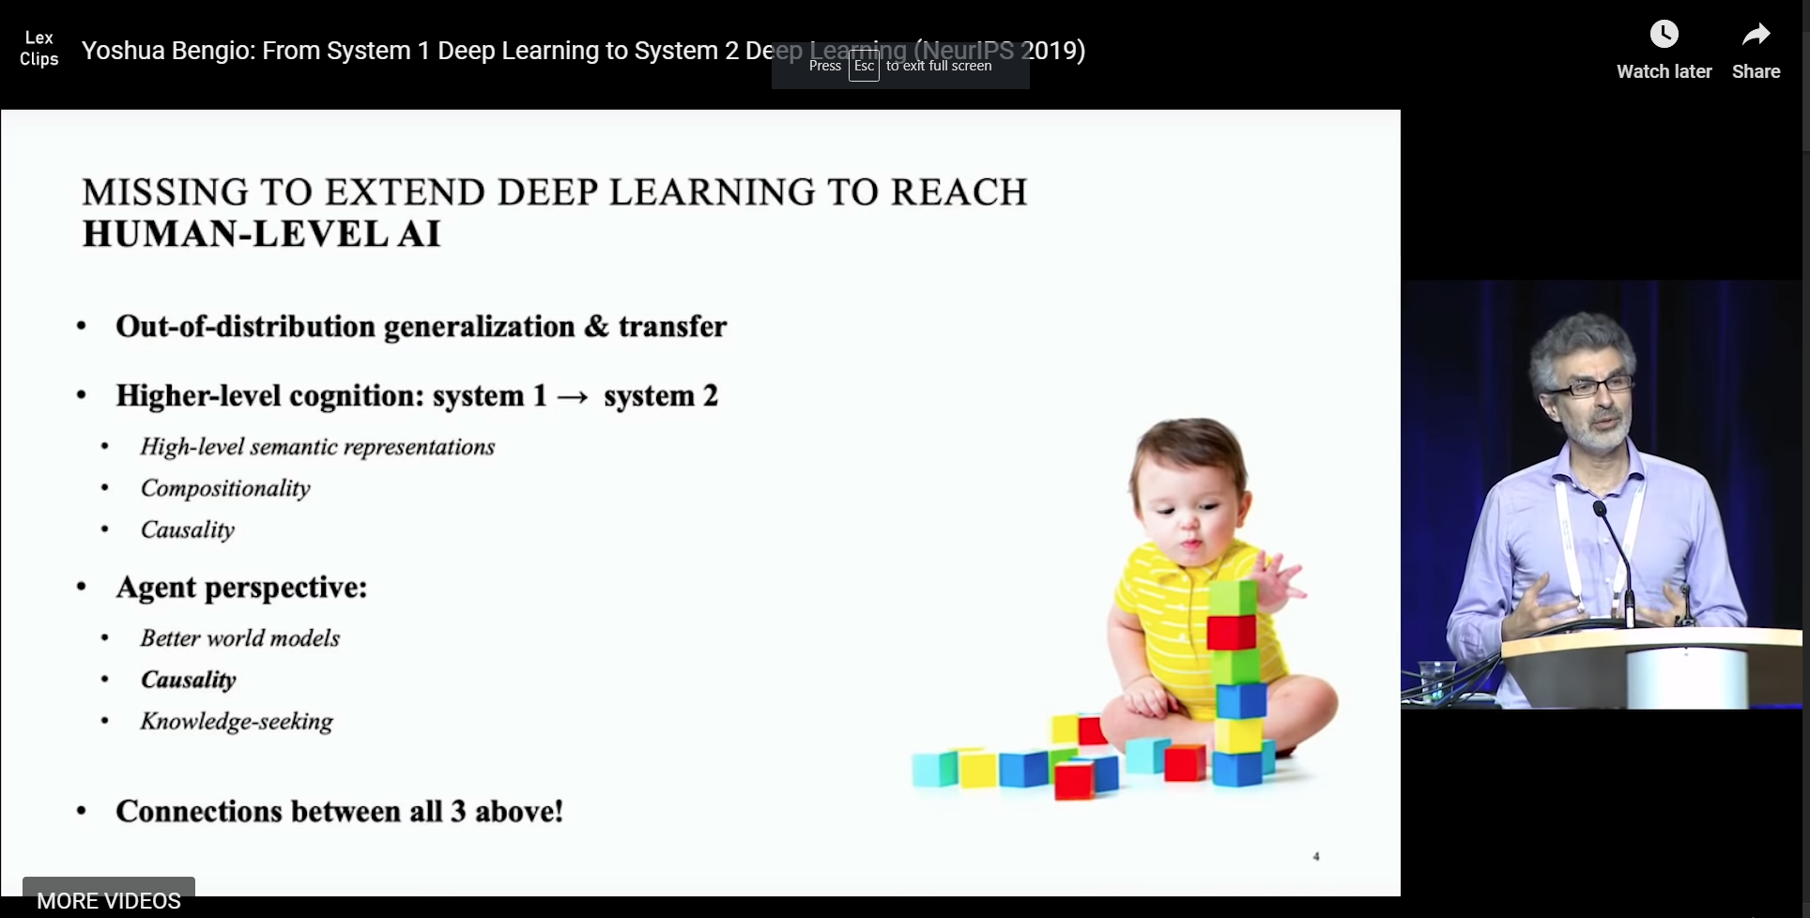

Slide 14
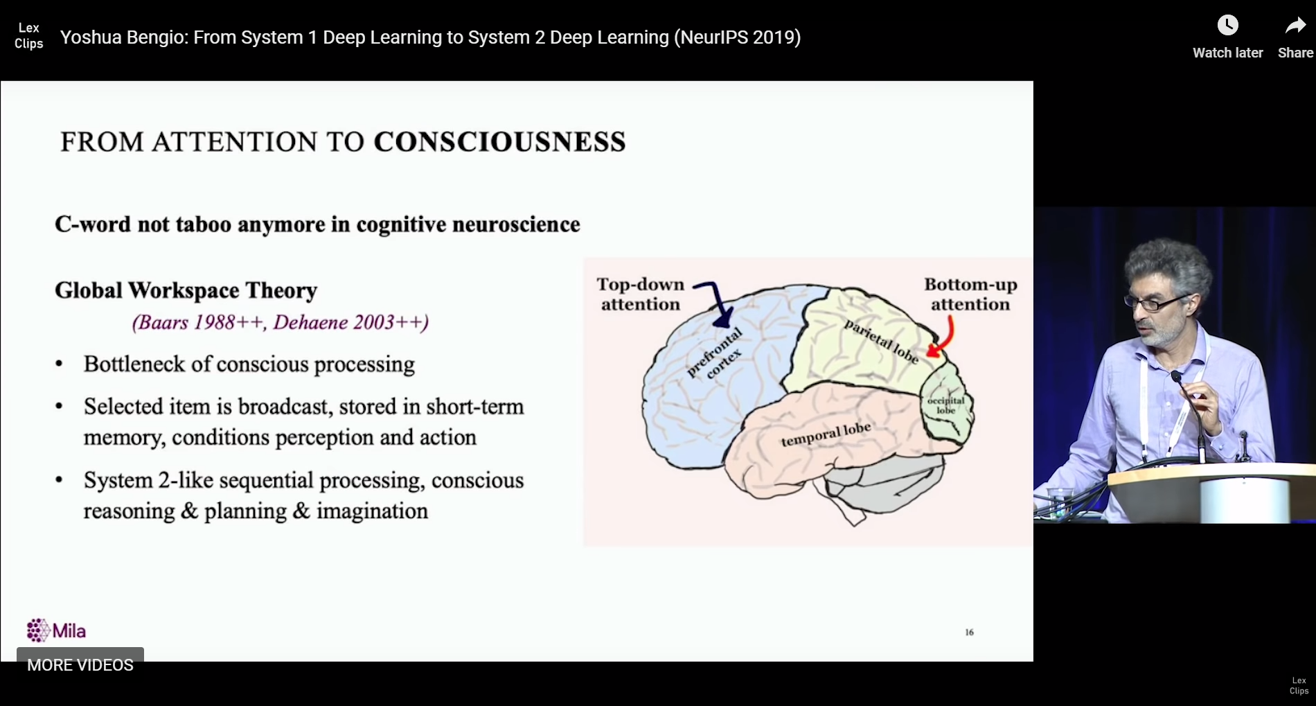

Slide 15
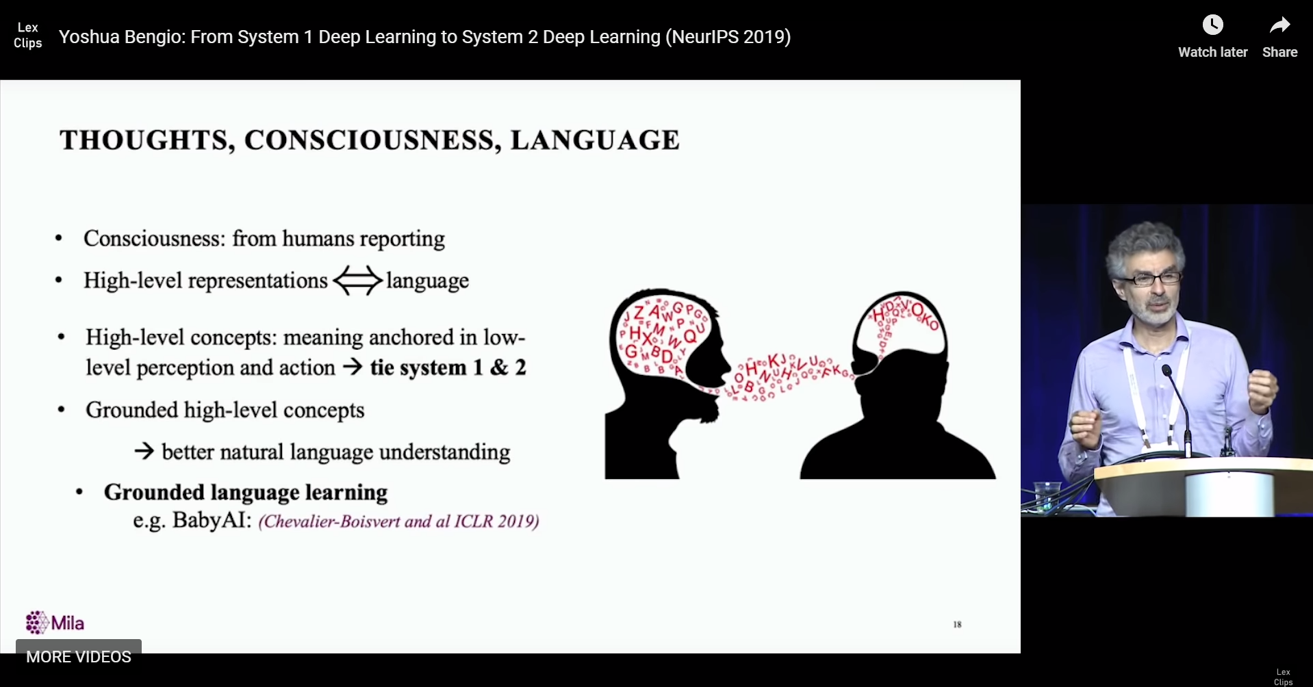

Slide 16

Independent Identical Distribution (IID) Out of Distribution (OOD)

Slide 17






Representation learning – At a sentence level
Information A
Encoder
Information
B
High Dimensional Vector space

Slide 18
Why special tools for language?
Language is a lossy transform, when ideas in mind get translated into symbols, they miss out on a lot of context, capture only what the writer deems important.
Humans are great at extrapolating OOD, like imagining the universe while reading a book, but machines aren’t there yet!
Symbols mean different things to different people and is influenced with that they have seen throughout their lives, in addition, the meaning of symbols changes over time.

Slide 19
Why special tools for language?
No defined unit of information.
Meaning might or might not exist on character level, char-gram level, word level, phrase level, sentence level, or sometimes even at a document level.
Sequence of symbols, where some symbols act as transforms over the symbols that came before or might come after.

Slide 20
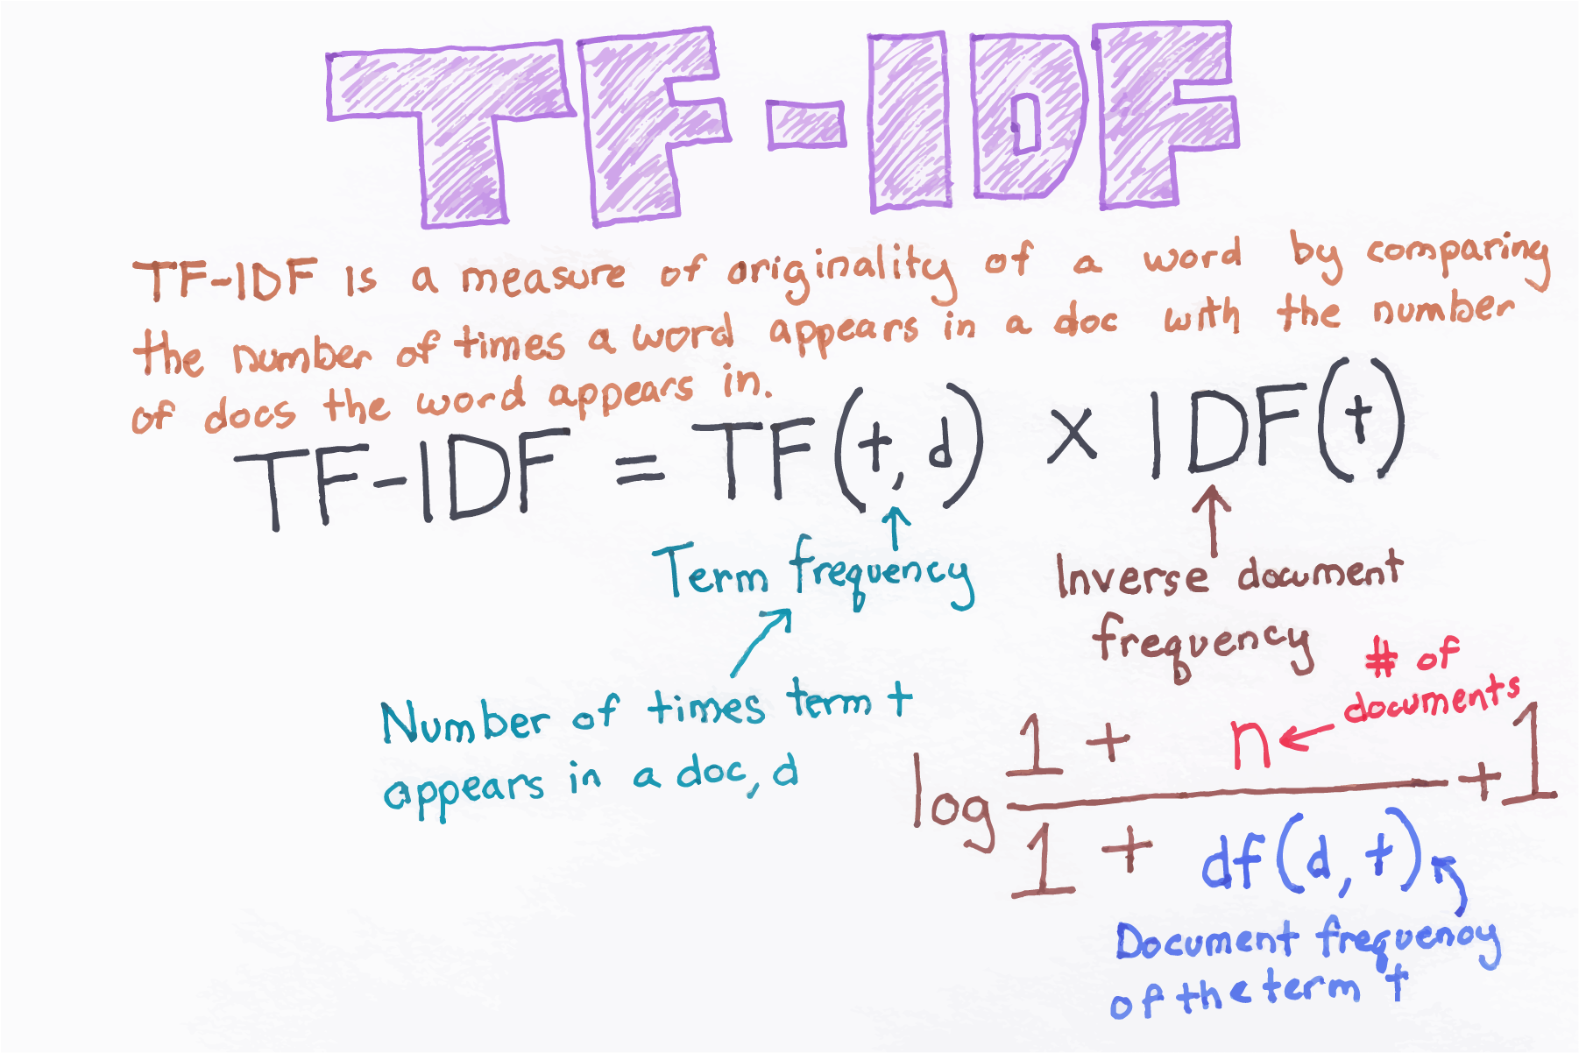
Classical NLP

Slide 21
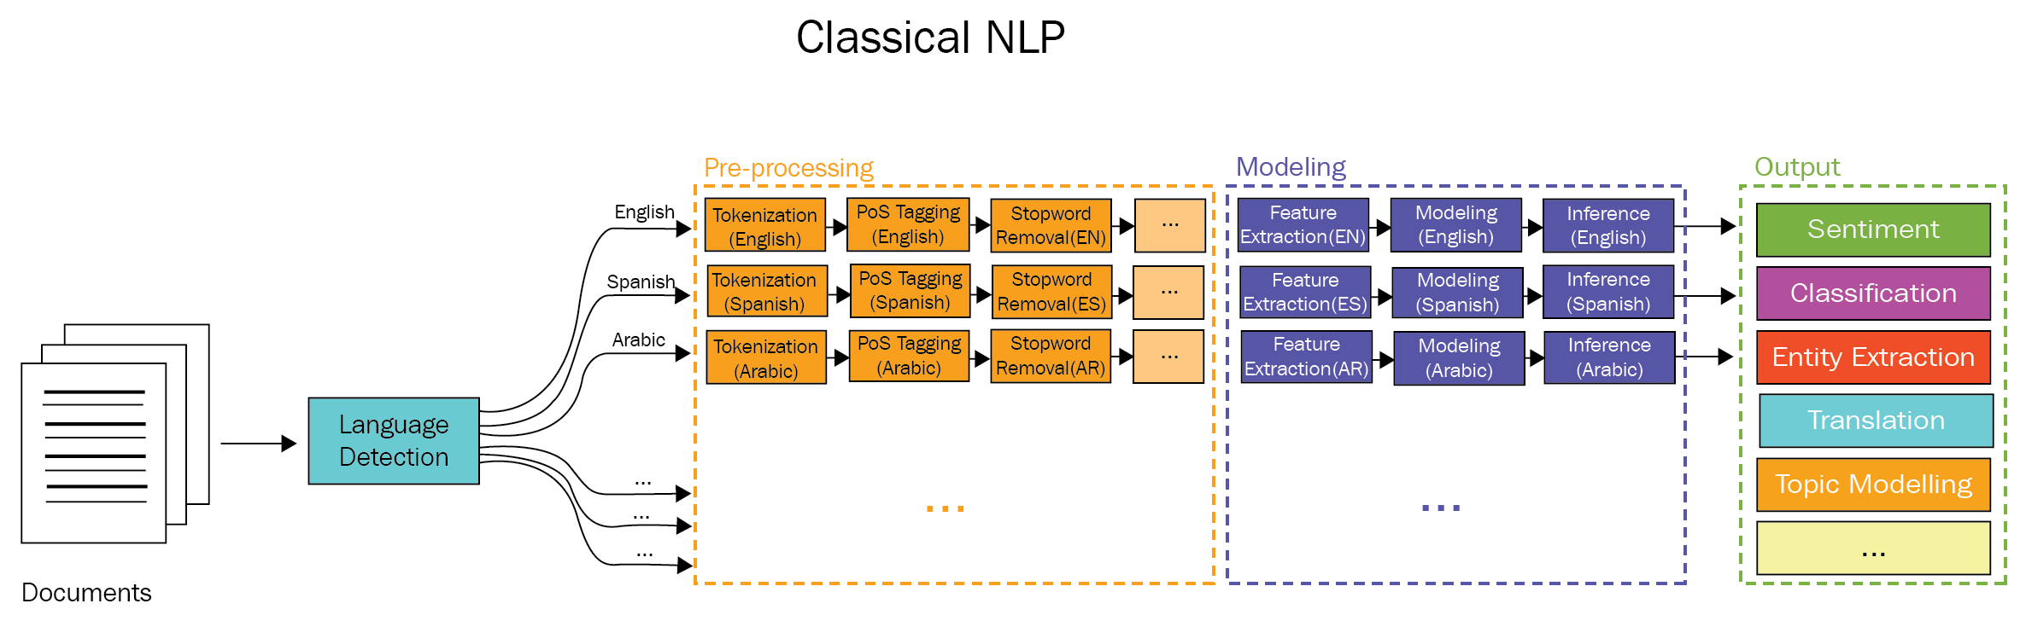
Early days
Rule-based NLP: Hand-coding set of rules such as by writing grammars or devising heuristic rules for stemming.
Statistical NLP: Late 1980’s to mid 1990’s.

Slide 22
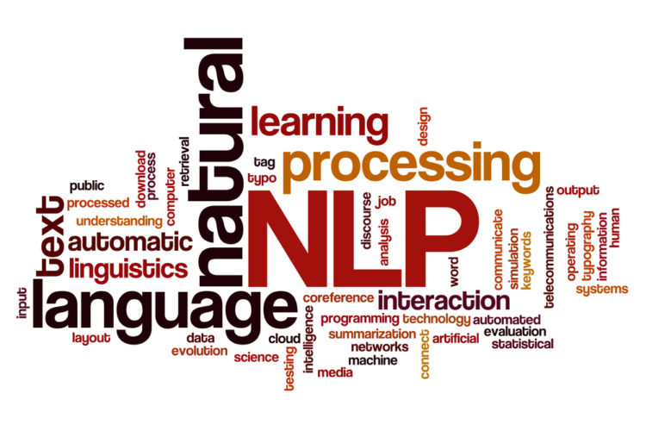
Stars of Classical NLP
Term Frequency Inverse Document Frequency (TFIDF)
Best Match 25 (BM25)
Latent Dirichlet Allocation (LDA).
Pointwise mutual Information (PMI).
Dependency graphs.
Stemming, Lemmatization, POS tagging, IOB tagging
One-hot encoding

Slide 23
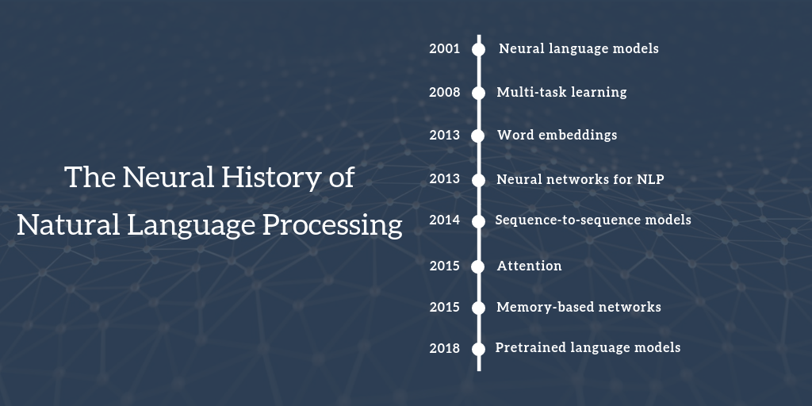

Slide 24
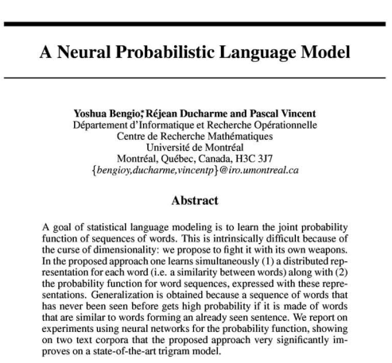
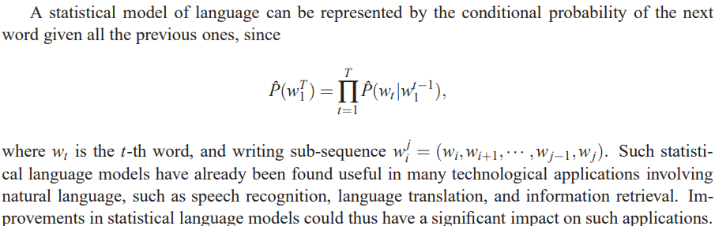
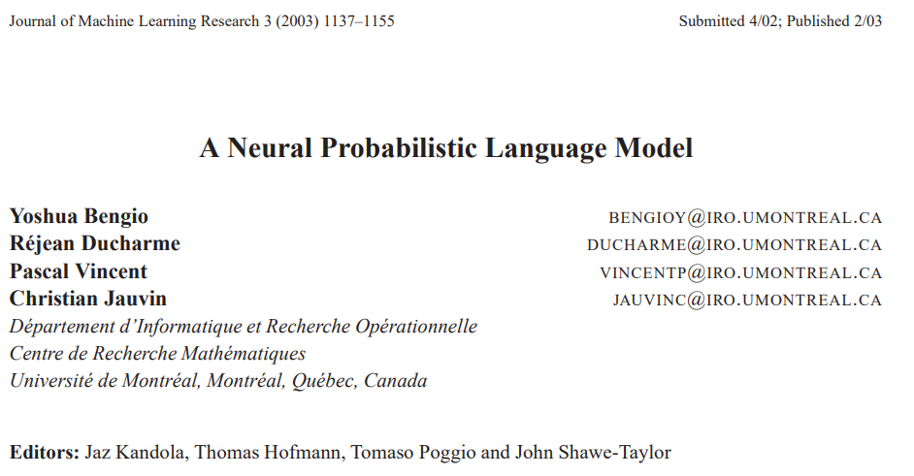
https://papers.nips.cc/paper/1839-a-neural-probabilistic-language-model.pdf
http://www.jmlr.org/papers/volume3/bengio03a/bengio03a.pdf

Slide 25
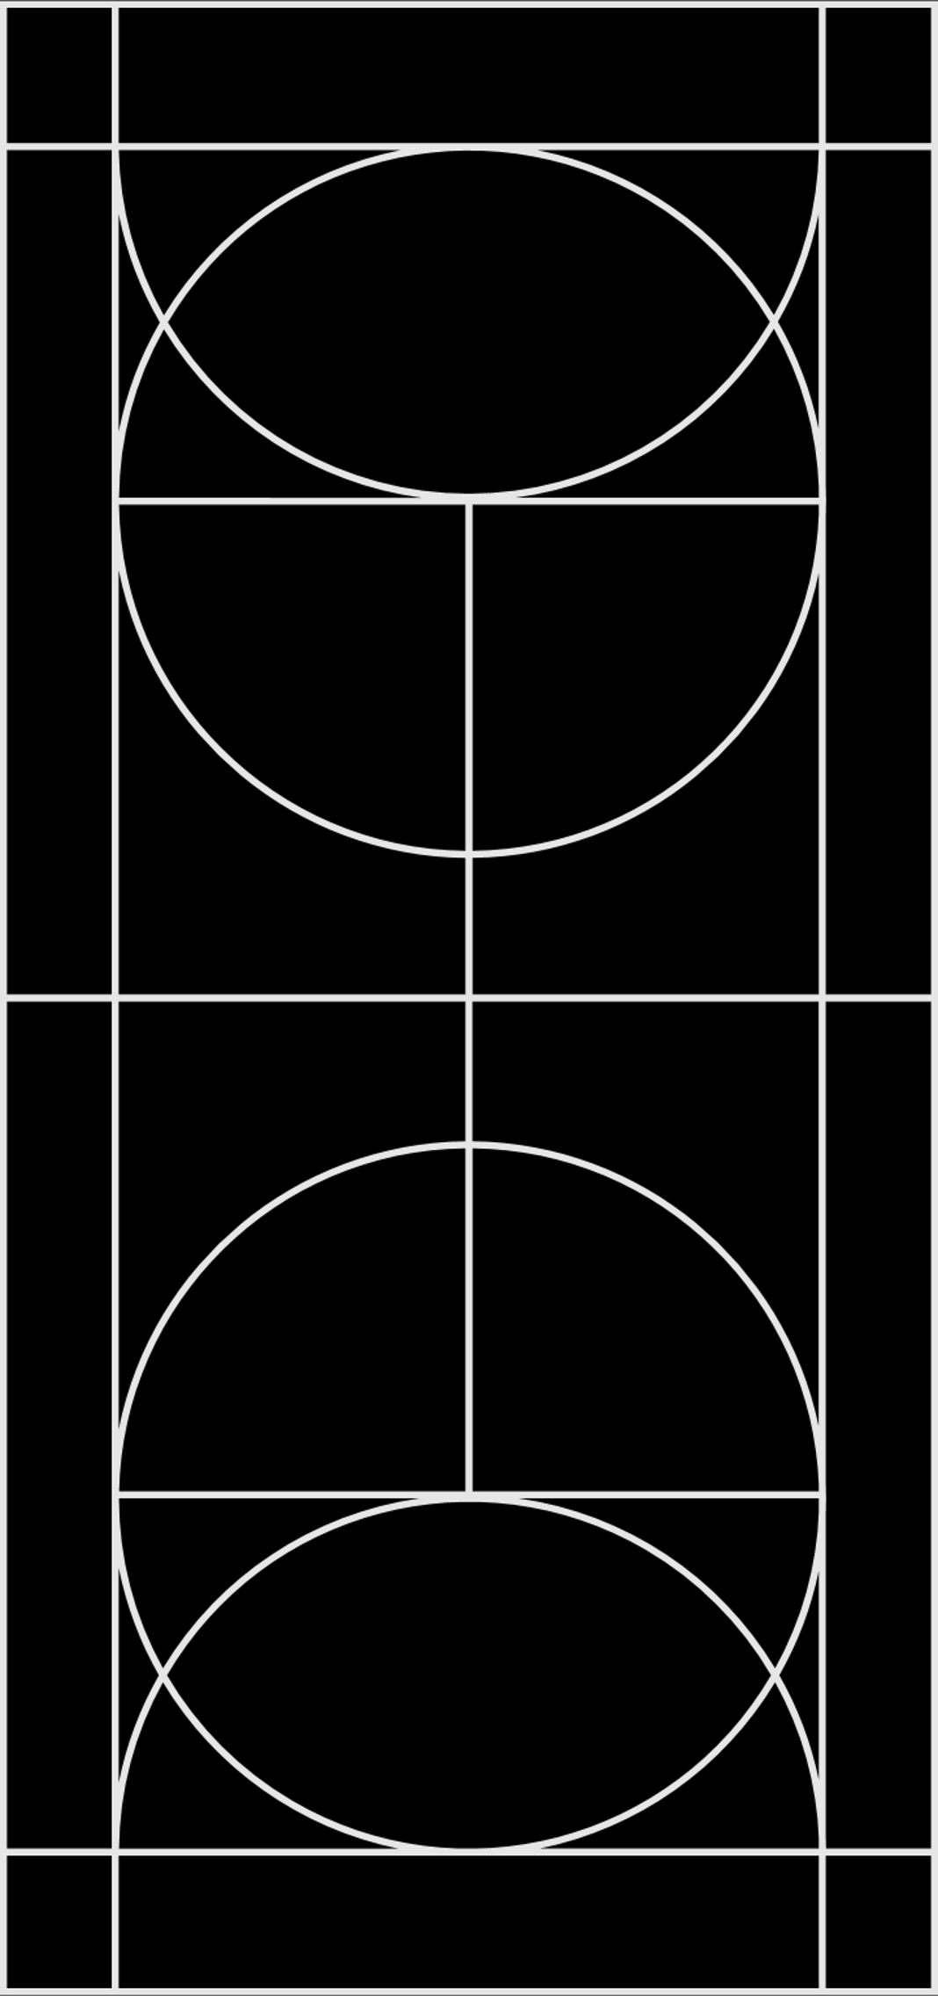

“A man is known by the company he keeps”
Era of embeddings
Word2Vec
Glove: Global vectors for word representation
FastText
Poincare hierarchical representations

Slide 26
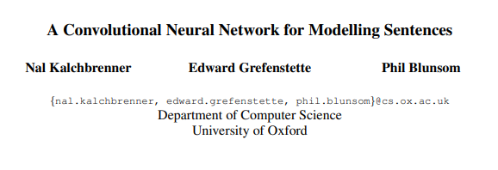
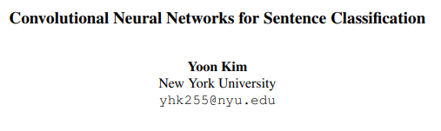
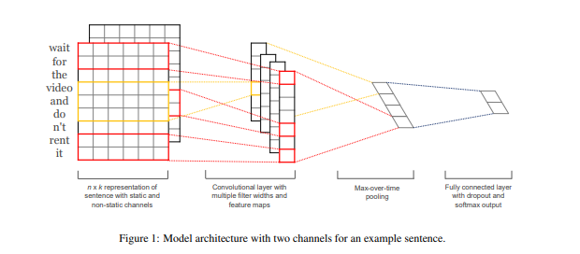
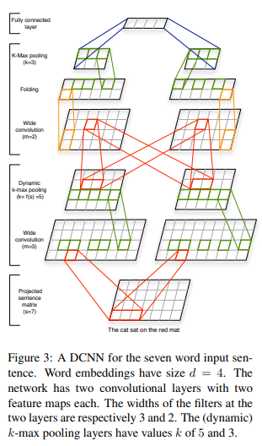
Convolution Neural Networks
Notes:
https://towardsdatascience.com/transformers-141e32e69591
Advantages of CNNs

Slide 27
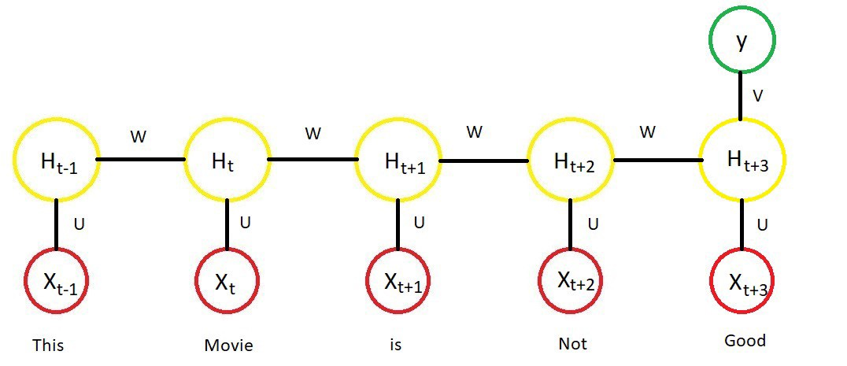

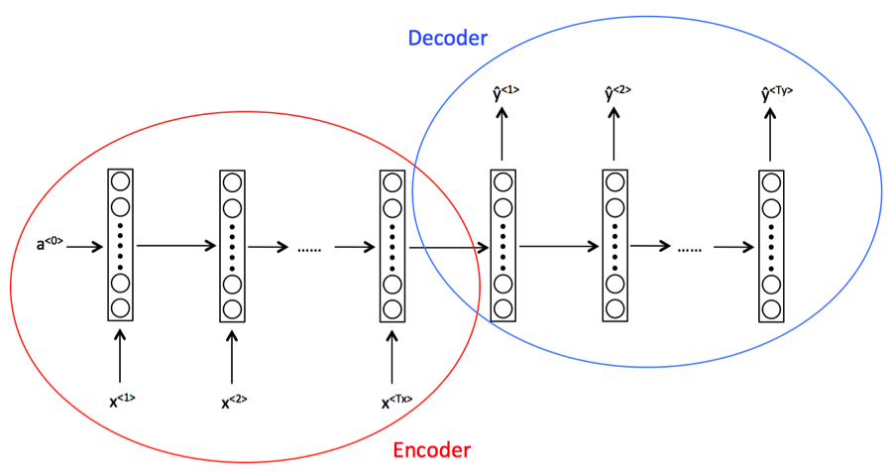
Recurrent Neural Networks, Seq2Seq models
Notes:
http://colah.github.io/posts/2015-08-Understanding-LSTMs/
Advantages of RNNs

Slide 28
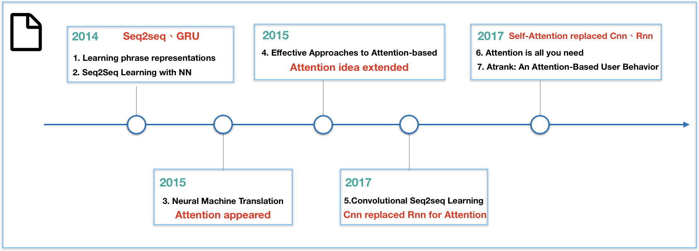

Slide 29
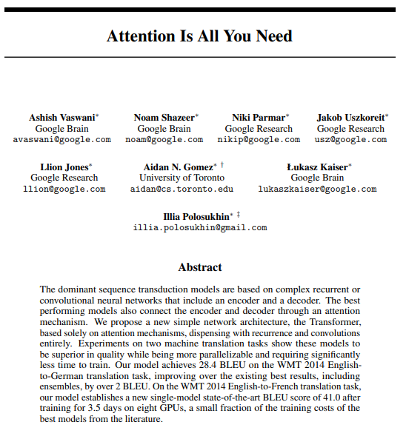

Slide 30


Era of Pretrained Language Models & Contextual Word Embeddings

Slide 31
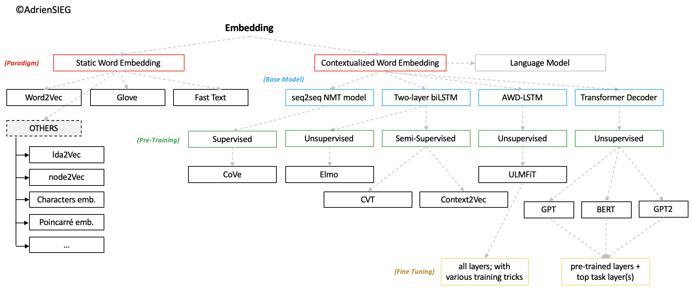
From Pretrained Word Embeddings to Pretrained Language Models
https://towardsdatascience.com/from-pre-trained-word-embeddings-to-pre-trained-language-models-focus-on-bert-343815627598
Notes:
Deep Contextualized Word Representations
Embeddings from Language Models

Slide 32
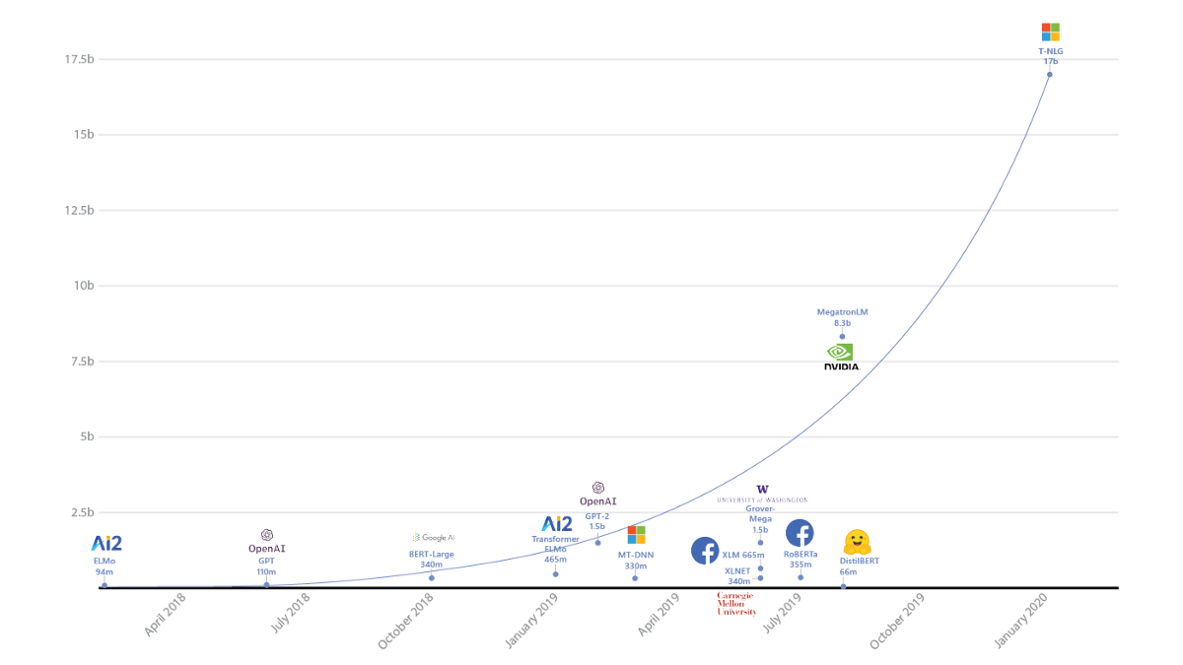

Slide 33
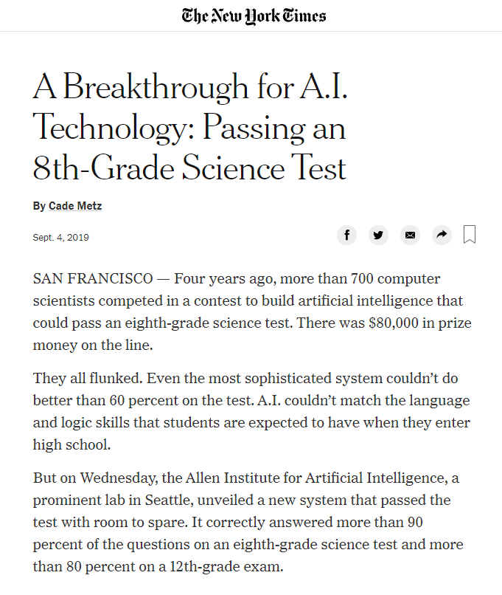
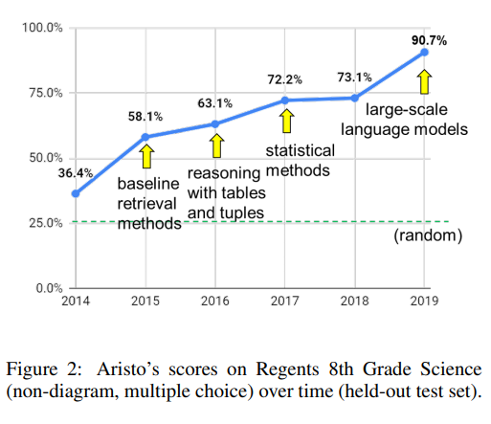
https://arxiv.org/pdf/1909.01958.pdf

Slide 34
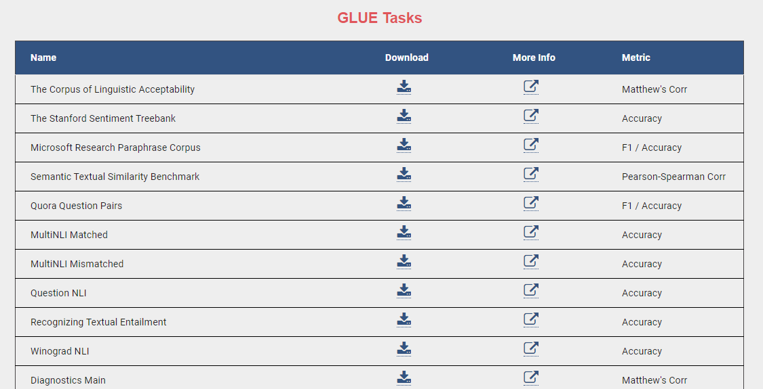

Slide 35
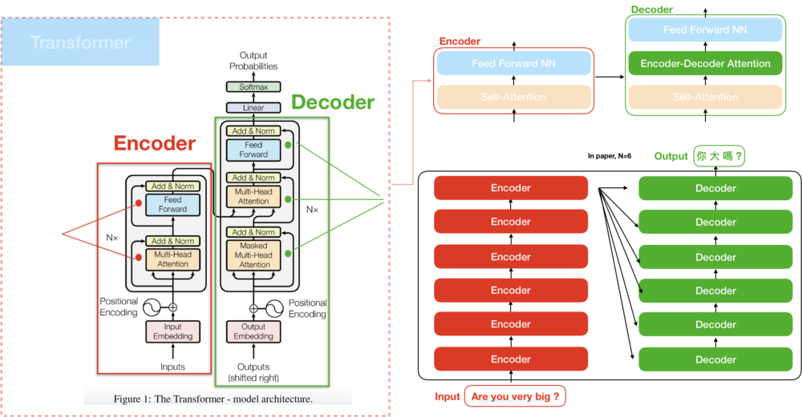
Transformers
Notes:
https://mc.ai/seq2seq-pay-attention-to-self-attention-part-2/

Slide 36
Transformers
Transformers demonstrate that recurrence and convolution are not essential for building high-performance natural language models.
They achieve state-of-the-art machine translation results using a self-attention operation
Attention is a highly-efficient operation due to its parallelizability and runtime characteristics.
Notes:
https://mostafadehghani.com/2019/05/05/universal-transformers/
http://mostafadehghani.com/wp-content/uploads/2018/07/UTtransformer.gif
http://mostafadehghani.com/wp-content/uploads/2018/07/AdaptiveUT.gif

Slide 37
How to train a language model?
Each transformer train cycle model must have the following
Sub-word token vocabulary
A configuration file detailing the network architecture
Large language corpus, ex. Entire Wikipedia and some more.
Self-supervised tasks
For e.g. BERT uses two tasks, masked word prediction and next sentence prediction.
Lot’s of parallel compute power, GPUs or TPUs preferred.

Slide 38
What good is a pretrained transformer?
Great out-of-box performance with the potential for transfer learning.
Additional pretraining to domain specific corpus.
Fine tuning to specific tasks with limited data such as:
Named entity recognition
Natural Language Inference
Question Answering
Semantic Textual Similarity
Semantic Role Labeling, etc.

Slide 39
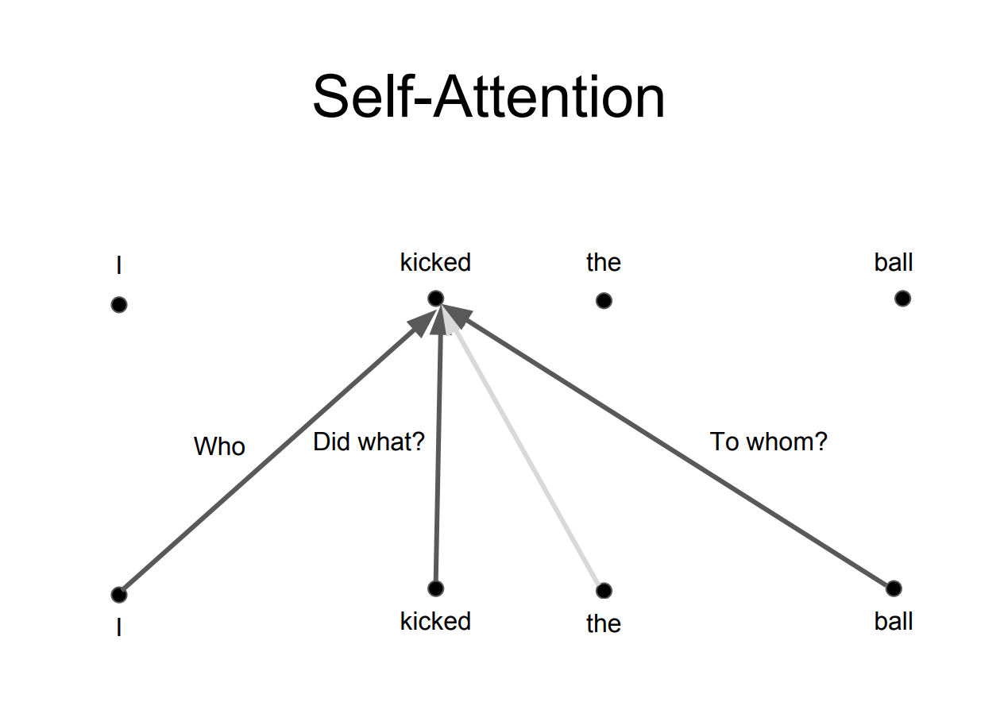
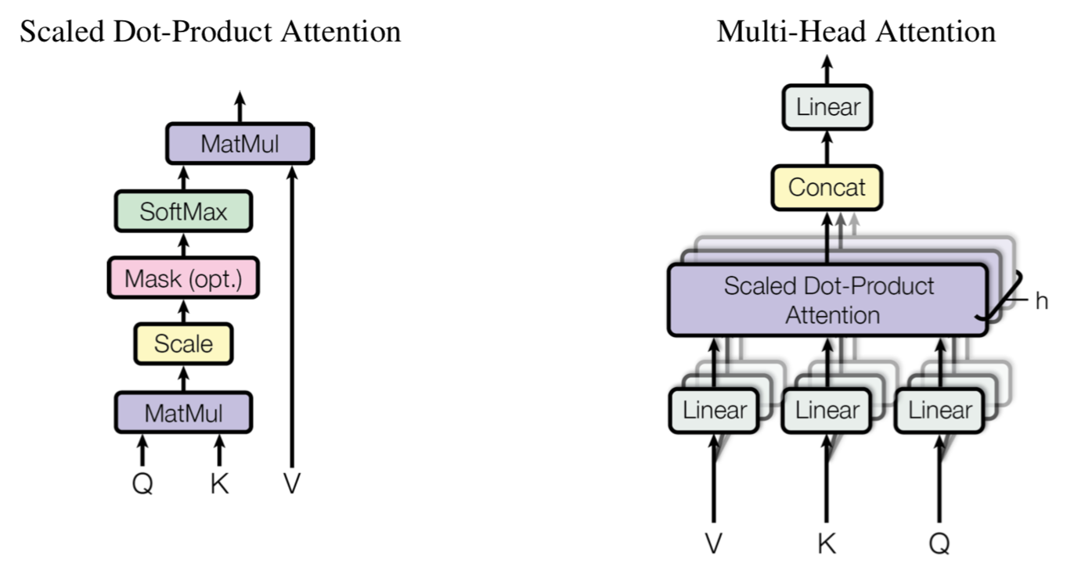
Self-attention

Slide 40

Self-attention Step 1

Slide 41
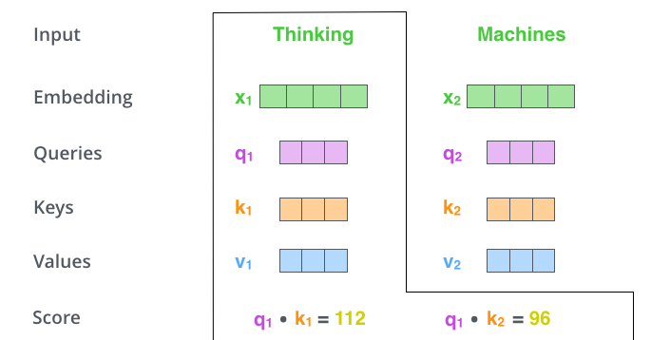
Self-attention Step 2

Slide 42
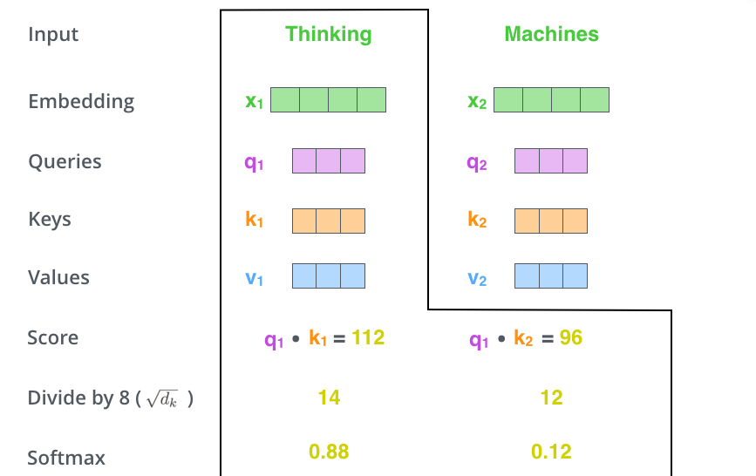
Self-attention Step 3-4

Slide 43

Self-attention Step 5-6

Slide 44
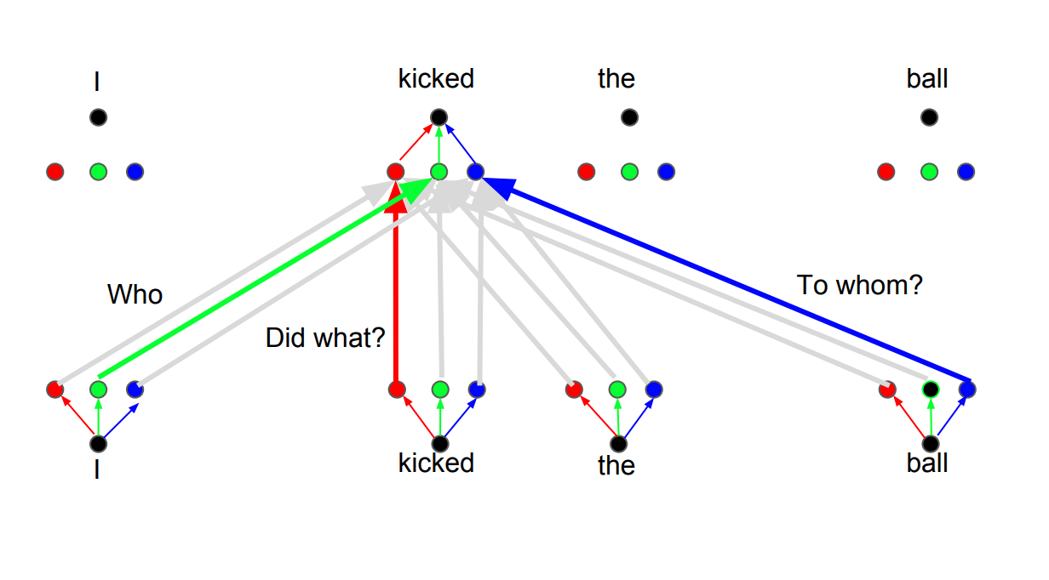
Multi headed attention

Slide 45
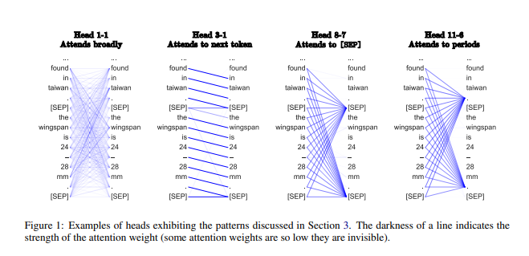
Visualizing attention
Demo
http://localhost:8888/notebooks/nlp/Transformer%20probe.ipynb

Slide 46
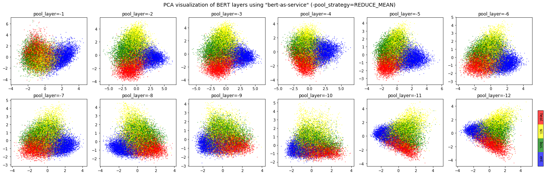
Semantic relatedness from BERT embeddings
https://github.com/hanxiao/bert-as-service#q-so-which-layer-and-which-pooling-strategy-is-the-best
4 classes, 20K news titles, UCI-News Aggregator Dataset

Slide 47
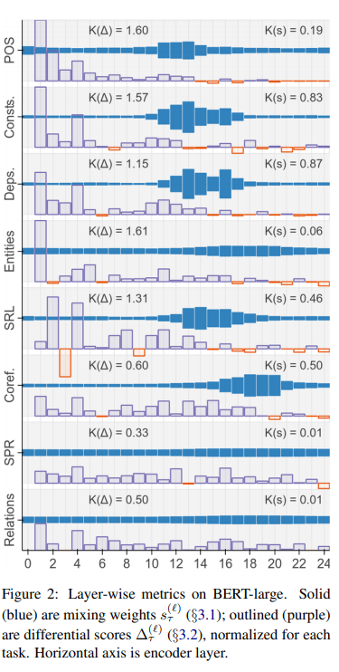
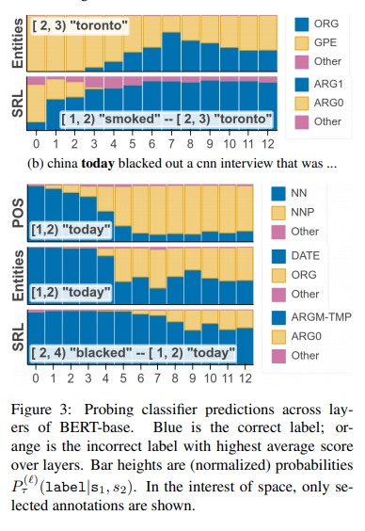
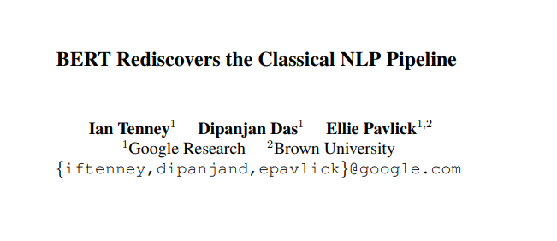
“…deep language models can represent the types of syntactic and semantic abstractions traditionally believed necessary for language processing, and moreover that they can model complex interactions between different levels of hierarchical information.”

Slide 48
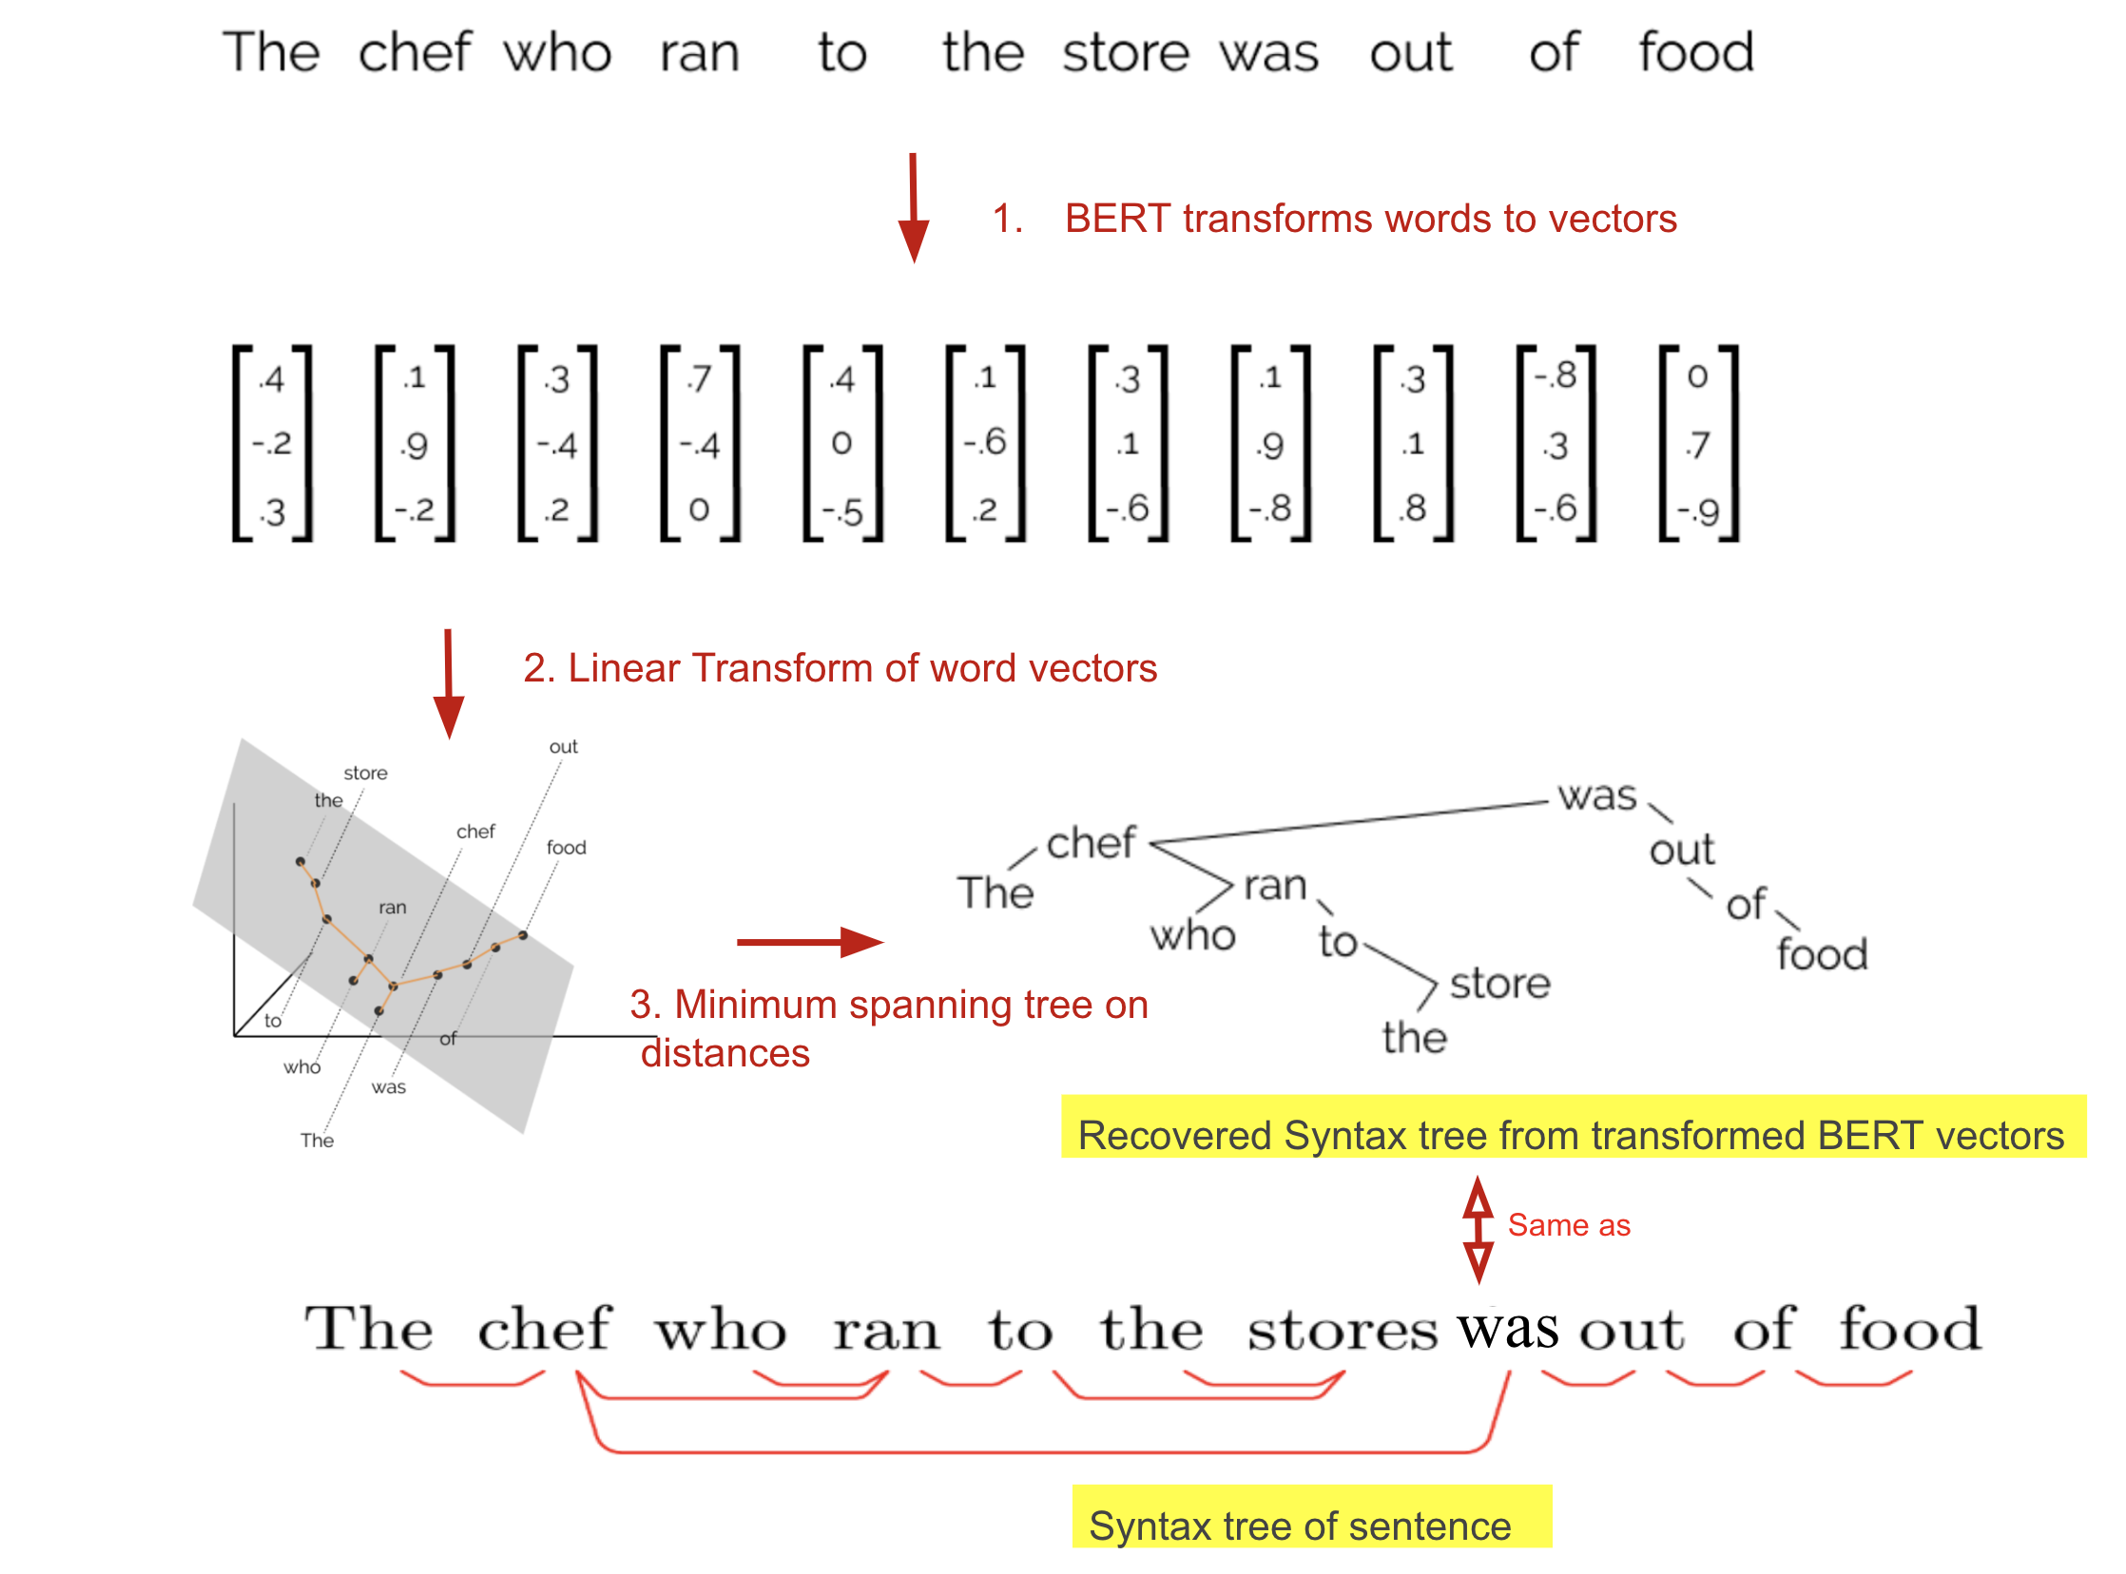
BERT can reconstruct parse trees from the Penn Treebank
We hope that the targeted case studies we’ve run on BERT and ELMo will be just the start of a wide range of inquiry into the syntactic properties of the geometry of contextualized word representations.
https://nlp.stanford.edu//~johnhew//structural-probe.html?utm_source=quora&utm_medium=referral#the-structural-probe

Slide 49
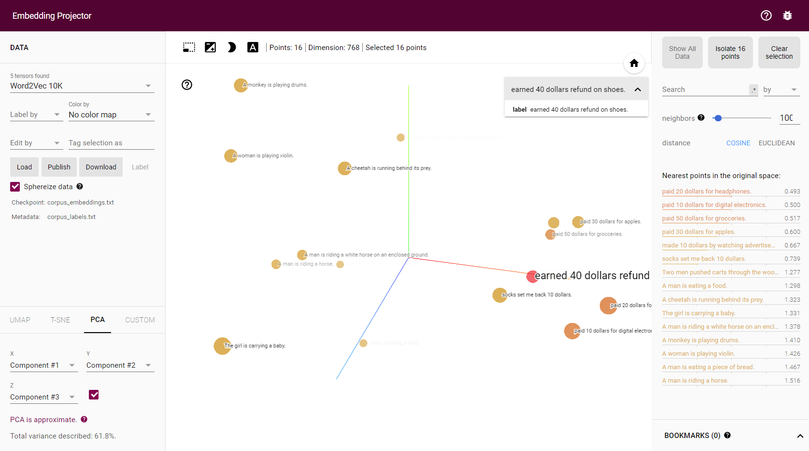
Semantic meaning
Demo
http://localhost:8888/notebooks/nlp/sentence%20to%20embeddings.ipynb

Slide 50
Language Generation Demo
https://transformer.huggingface.co/doc/gpt2-large

Slide 51
Questions
Thank you for your attention

Slide 52
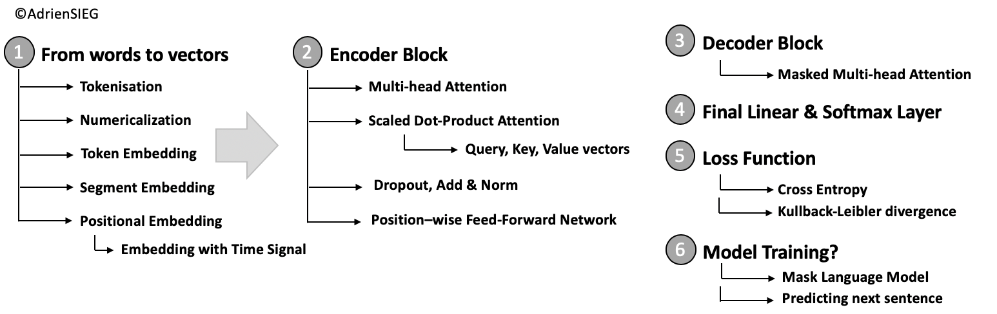
Dive deeper?

Slide 53

symbol of auspiciousness and good luck
symbol of oppression
Symbols mean different things!
https://www.npr.org/sections/codeswitch/2016/10/28/499475248/diwali-dilemma-my-complicated-relationship-with-the-swastika
https://www.npr.org/player/embed/499475248/499796189

Slide 54
Further Play
https://demo.allennlp.org/reading-comprehension
http://github/google-research/bert/
http://hunterheidenreich.com/blog/intro-to-word-embeddings/
https://cai.tools.sap/blog/glove-and-fasttext-two-popular-word-vector-models-in-nlp/
https://gluebenchmark.com/
http://jalammar.github.io/illustrated-bert/
https://towardsdatascience.com/from-pre-trained-word-embeddings-to-pre-trained-language-models-focus-on-bert-343815627598
https://github.com/huggingface/transformers

